Slide 1
News Posts’ Shares predicted through Regression and Classification
Under the guidance of Prof R Jha
Presented by Divyanshu Shekhar (BE/10253/2013)

Slide 2
Rise of Machine Learning
Grew out of work in AI
New capability of Computers

Slide 3
Wide Applications of ML
Database Mining Large datasets from the growth of automation/web. E.g web click data, medical records, engineering
Applications can’t program by hand E.g. Autonomous Helicopter, Handwriting Recognition, Natural Language Processing, Computer Vision.
Self Customizing Programs E.g. Amazon, Google Recommendations
Understanding Human Learning (Brain, Real AI)
Large scale companies e.g. Google, facebook etc are tremendously investing in this modern area.

Slide 4
What is Machine Learning?
“ML is the field of study that gives computers the ability to learn without being explicitly programmed” - Arthur Samuel.
“A computer program is said to learn from experience E with respect to some class of tasks T and performance measure P, if its performance at tasks T, as measured by P, improves with experience E” - Tom Mitchell.
AI Dream- To build machines as intelligent as human. The best solution is to learn algorithms trying to mimic how the human brain learns.

Slide 5
Classification of ML problems
Supervised Learning - In supervised learning, we are given a data set and already know what our correct output should look like, having the idea that there is a relationship between the input and the output.
Unsupervised Learning - Concern is to find a structure in the dataset where we don’t necessarily know the effects of the variables and possess little or no Idea what our results should look like. - e.g. Social Media, Market Segmentation

Slide 6
Supervised Learning
Regression - results within a continuous output - e.g - given a picture of person, predict the age of the person.
Classification - Discrete Output - e.g. - Given a patient with tumor, predict whether the tumor is benign or malignant.

Slide 7
Literature Review I
A Comparative Study of Classification and Regression Algorithms for Modelling Students’ Academic Performance
This paper’s conclusion tells that classification algorithm produces a better performance than the regression algorithms.
This helps in solidifying the concept that prediction must be based on several techniques and the analysis of those results obtained.

Slide 8
Literature Review II
A Comparison Of Logistic Regression, Neural Networks, and Classification trees in a study to predict success of actuarial students.
The conclusion of this papers says that although logistic regression method works well for a variety of problems but more accurate results can be obtained by deploying different other algorithms

Slide 9
Selection of Dataset
While selecting the dataset, few points were kept in mind
Selecting a dataset which can be utilised for regression and classification problem as well.
Have training examples in the order of 10, 000
Multivariable features

Slide 10
Online News Popularity
Set of features about articles published by Mashable in two years.
Number of instances- 39k
58 predictive fields, 1 goal field( no of shares)
No of words, no of images, etc are few among the predictive features.
Using ML, “no of shares” would be predicted using different techniques.

Slide 11
Techniques Implemented
Linear Decision Boundary
Linear Regression using Gradient Descent Method
Linear Regression using Normal Method.
Polynomial Decision Boundary
Gradient Descent Method.
Normal Method.
Logistic Regression

Slide 12
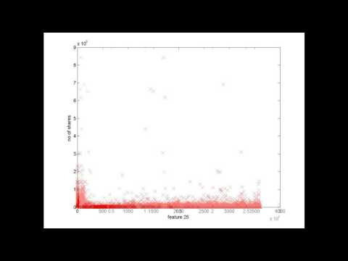
Visualaisation of Data

Slide 13


Gradient Descent Method
Hypothesis Function
Cost Function
Feature Scaling and Mean Normalisation
Gradient Descent Convergence

Slide 14
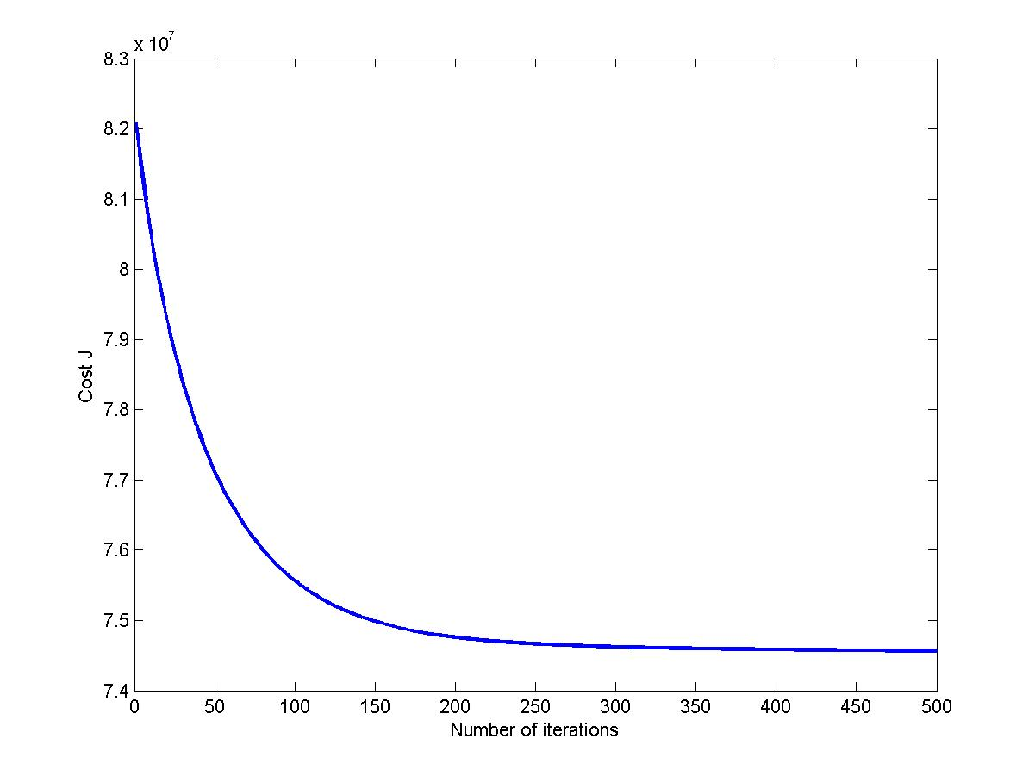
Cost Function for gradient Descent Method
Cost Function decreases with iterations.
Learning rate, alpha= 0.03

Slide 15
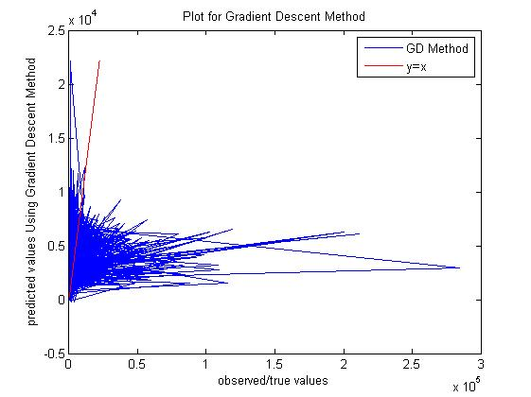
Prediction(GD Method)
Training Accuracy- close to zero
Accuracy is found to be approx 6% when 10% of shift in predicted values are acceptable.
When 20% of shift is acceptable, accuracy is approx 12%

Slide 16

Normal Method
Method of finding optimum theta without iterations.
No need of feature scaling
.

Slide 17
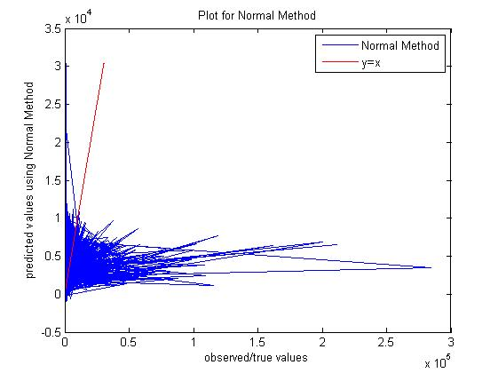
Prediction(Normal Method)
Training Accuracy close to zero.
Accuracy is found to be approx 7% when 10% of shift in predicted values are acceptable.
When 20% of shift is acceptable, accuracy is approx 13%

Slide 18
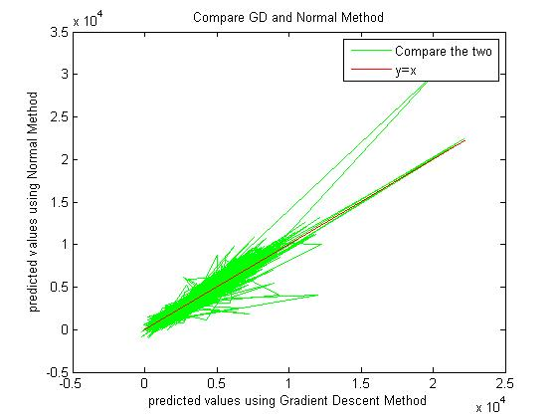
Compare GD and Normal Method Results
Similarity in the results by 2 methods can be seen here.
Several “theta” or weight values were almost same in the two cases.

Slide 19
Polynomial Regression
Hypothesis function need not be linear, if it doesn’t fit the data well.
We can change the curve of our hypothesis by making it quadratic, cubic or any other form.

Slide 20
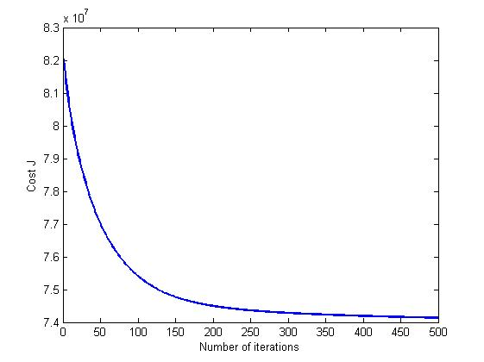
Cost Function(GD) for Polynomial Regression
Cost Function Decreasing
Learning Rate, alpha= 0.01

Slide 21
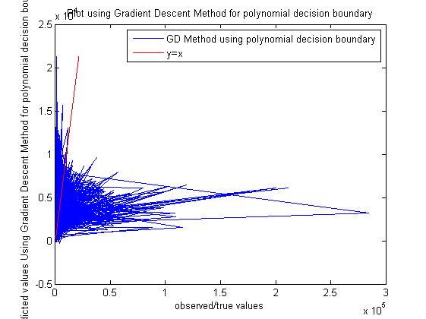
Prediction(GD) for Polynomial Regression
Training Accuracy close to zero.
Accuracy is found to be approx 6% when 10% of shift in predicted values are acceptable.
When 20% of shift is acceptable, accuracy is approx 12%

Slide 22
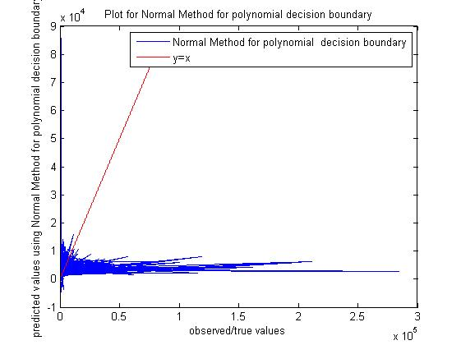
Prediction(Normal) for Polynomial Regression
Training Accuracy close to zero.
Accuracy is found to be approx 5% when 10% of shift in predicted values are acceptable.
When 20% of shift is acceptable, accuracy is approx 9%

Slide 23
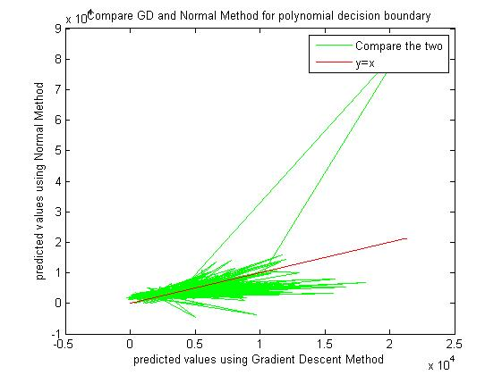
Prediction for GD and Normal Method for Polynomial Regression

Slide 24
Conclusion
These algorithms are not working well enough to predict the goal output “practically” correct.
Need to search for other algorithms
Possibly, many more suitable instances required to learn properly.
Manipulation of features are necessary.

Slide 25
Fututre Works
Finding the most effective algorithm to predict the number of shares and studying the behaviour of these algorithms.
Applying several techniques such as Neural Network, etc
Different View :- Seeing the “number of shares” as discrete values, apply the classification algos and compare it with regression results.
Creating a predictor of graph behaviour of different features and utilising it to form hypothesis function.

Slide 26
References
https://archive.ics.uci.edu/ml/datasets/Online+News+Popularity
http://www.educationaldatamining.org/EDM2015/uploads/papers/paper_158.pdf
http://www.nedsi.org/proc/2007/proc/p061011026.pdf
Huge thanks to Andrew Ng for his course materials on Coursera.

Slide 27

Thank you

